Slide 1
CEIS110
Introduction To Programming
Final presentation
Hunter Wilson

Slide 2
Introduction
This presentation will cover everything I have learned in the CEIS110 Introduction to Programming class over the last eight weeks. I have thoroughly enjoyed being apart of this class as it was both interactive and provided me with a better understanding of programming, coding, and the languages associated with the processes.

Slide 3
Challenges
My biggest challenge in this class was understanding float and integer division, and I often struggled with the Modulo operation as well. To better understand both forms of division and the Modulo operation I practiced using both in Python and found a few useful videos better explaining their uses.

Slide 4
Career Skills Obtained
Basic understanding of software development, flowcharting, pseudocode, and the IPO model.
Coding with Python.
Understanding control structures, relational/logical operators, loops, and string comparison.
Keywords, variables, and functions in coding.
Data Analytics/error handling.

Slide 5
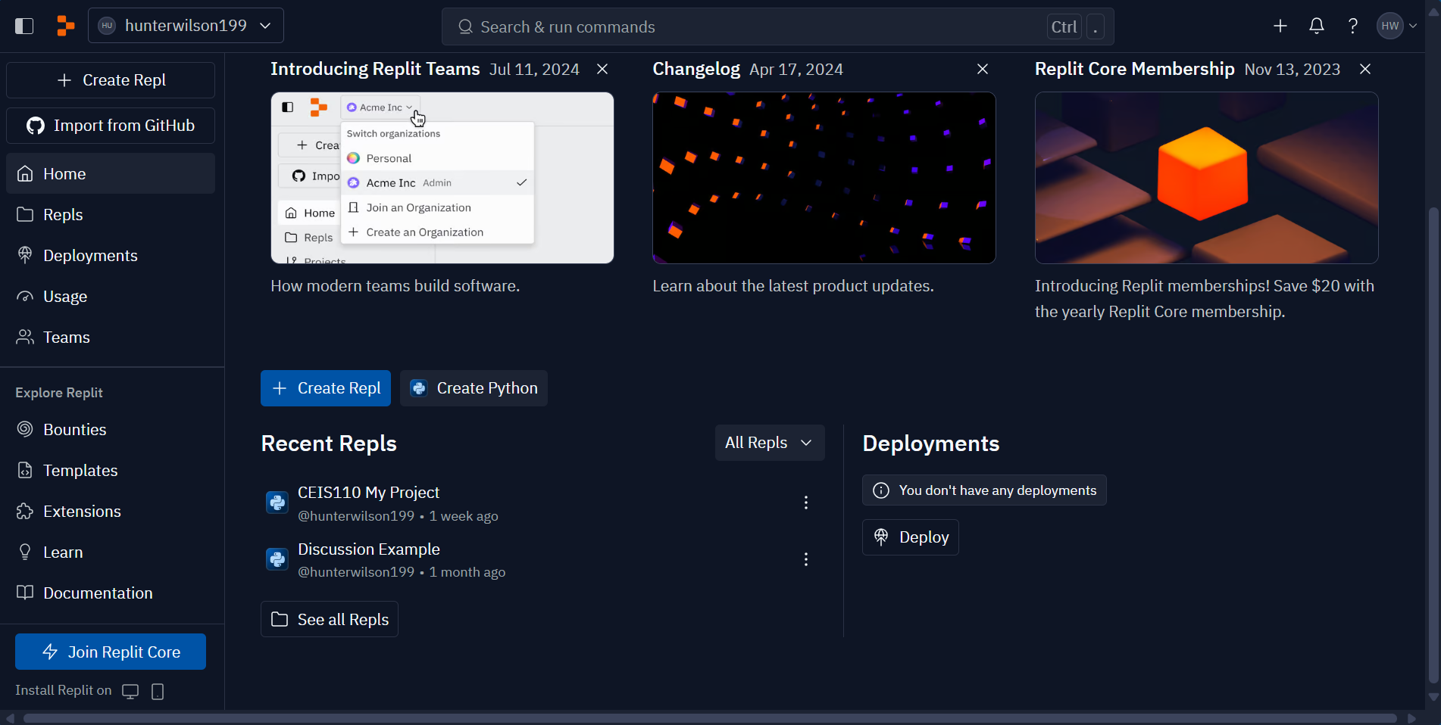
Software Instillation
At the beginning of our class after studying our first two lessons, Intro to Software Development and Selection Control Structures. I installed the free-to-use Anaconda programming application onto my computer and set up an account with Replit to create Python programs, which we used for most of our projects as a class.
Replit – Build software faster

Slide 6
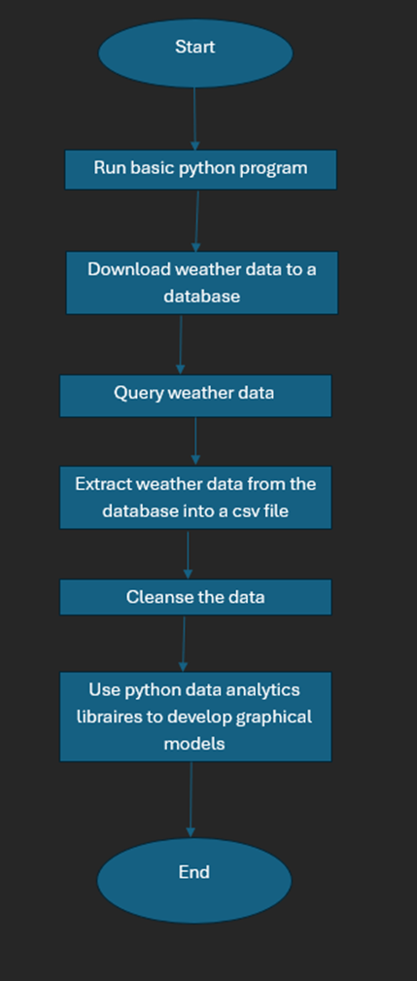
Flowchart prep
Before I created any programs, I first created a flowchart that shows the order in which a weather data program would run in Python. This flowchart helped me better understand the order of operations used when running a program and writing code.

Slide 7
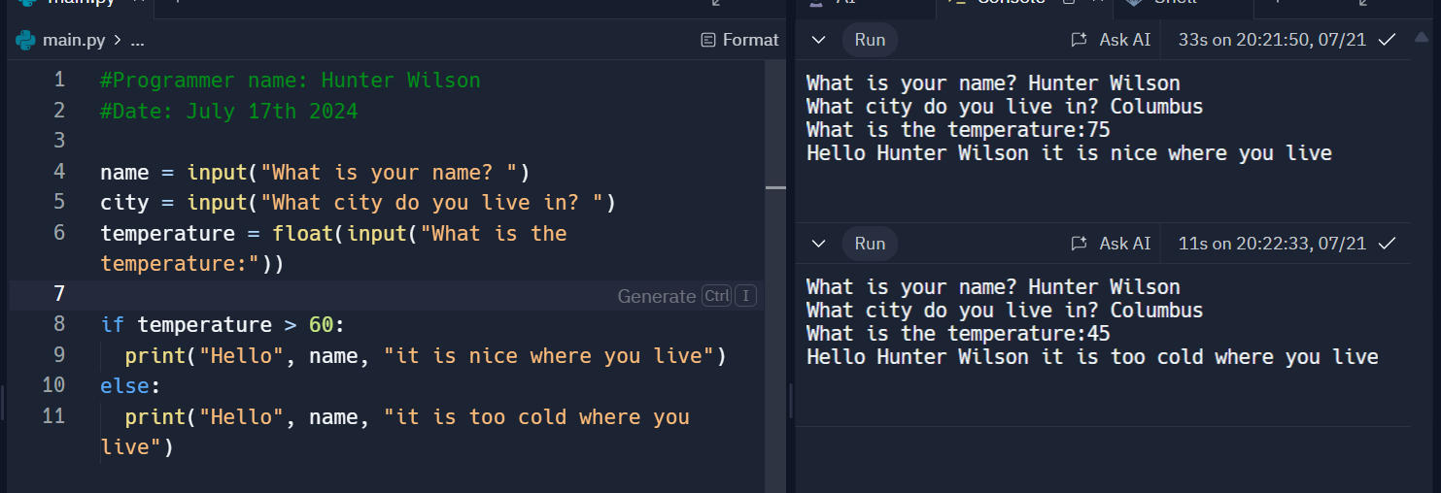
Weather Data Program
Using Replit, I created and ran a program that would tell me the temperature of my current location using weather data downloaded from The US National Oceanic and Atmospheric Administration (NOAA). This code also displayed my name and location using input commands. By using if and else functions I was able to have the program run two different print commands depending on the variable temperature > 60. The right side of this image shows two results of running the code successfully.

Slide 8
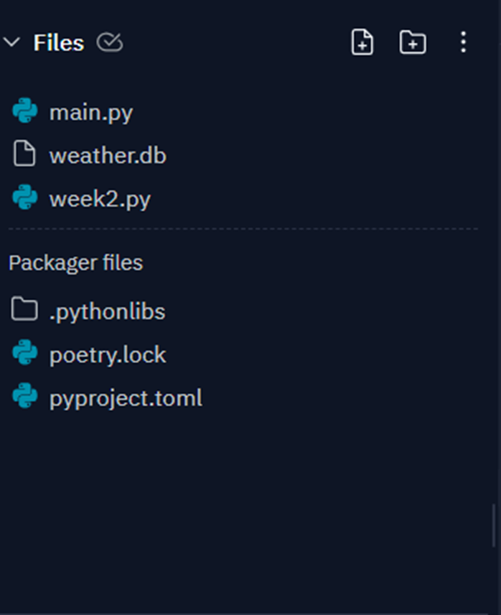
BuildWeather.Db File
My next steps in the weather program was to build a coding process that used my zip code as well as the data from NOAA to calculate how many rows of data there was over a 14-day period in my local region.

Slide 9
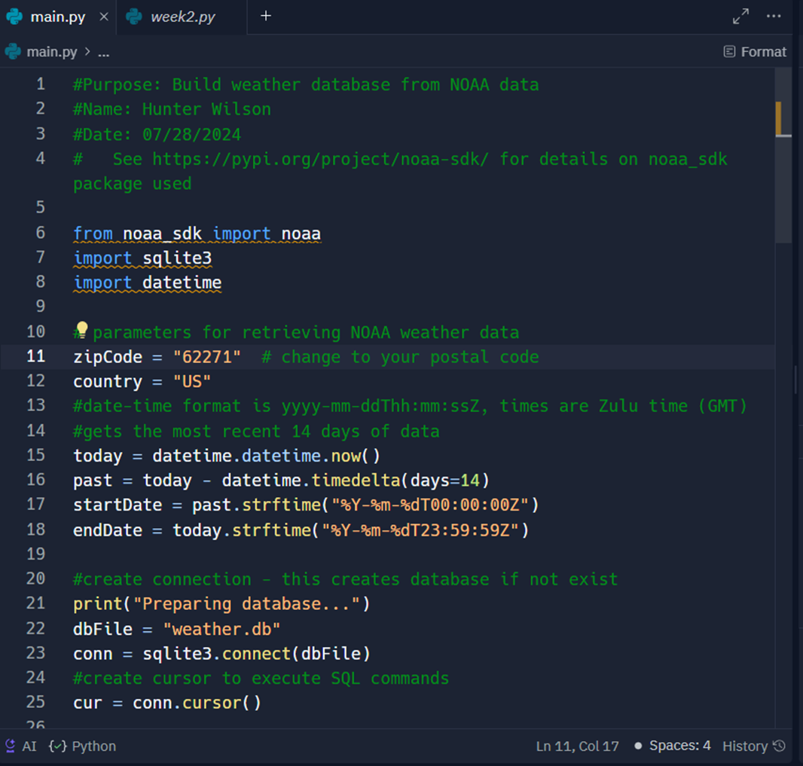
WeatherBuild Code
The image shows the code used to calculate the number of data rows in the program. This was achieved by importing NOAA’s weather data and setting the proper parameters for the zip code and country variables. I then used the datetime function to generate the last 14 days worth of data up to the current date of the project, then finished with the code printing the results.
Note: The green # lines give a detailed explanation of the intended output of the code below it.

Slide 10
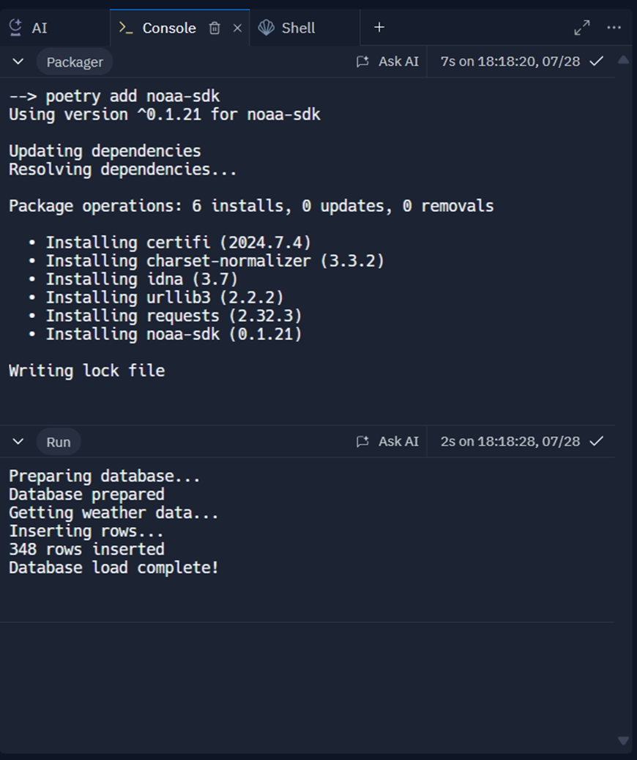
WeatherBuild OUtput
To run the program, I first needed to install the noaa-sdk packager and update all dependencies so my code would run and receive the proper data. Once complete I ran the program successfully and retrieved over 348 rows of data over a two-week period. This shows just how often the weather fluctuated in my local region and just how much data is generated over such a short time.

Slide 11
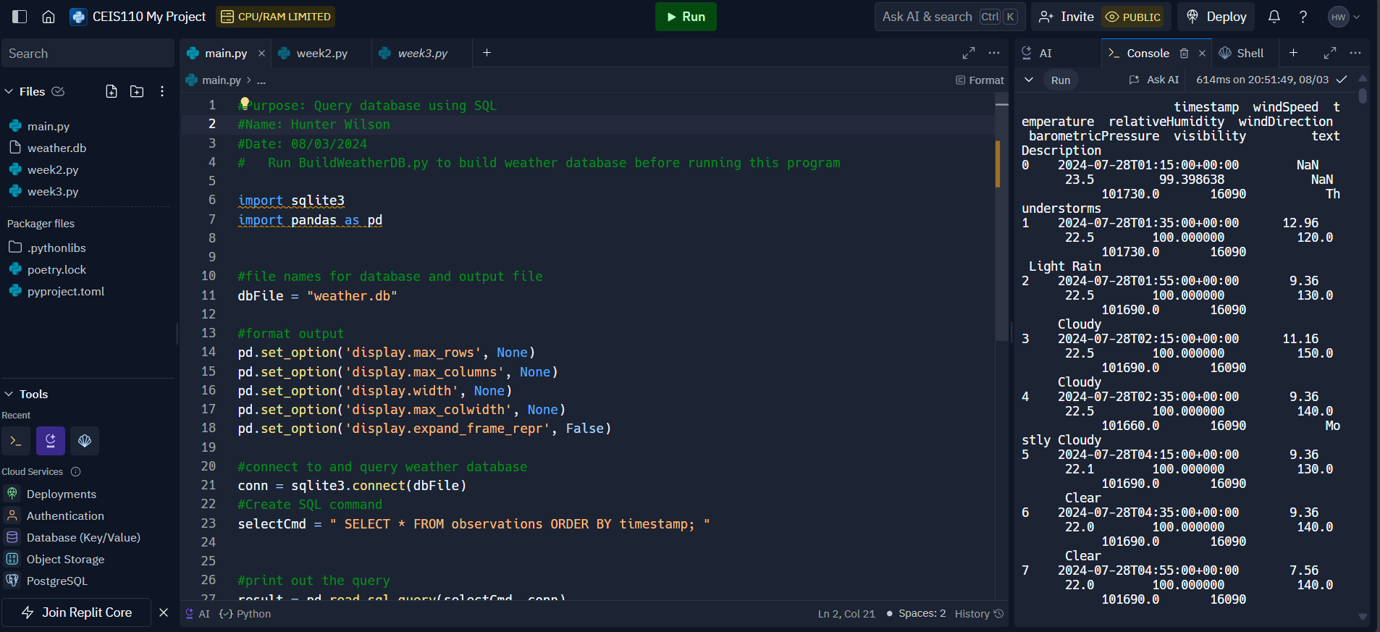
Querying with SQL
SQL (Structured Query Language) is a computer language that is used to organize, manage, and retrieve achieved data from a computers database. To query the database using SQL, I used the same BuildWeather.db file that was used in the last project and imported the SQL database reader along with pandas, which is a two-dimensional data structure. and then ran the code you see in the top right image. By adding my zip code to the program, I was able to receive over 200 packets of archived weather data for my local area.
Note: The green # lines give a detailed explanation of the intended output of the code below it.

Slide 12
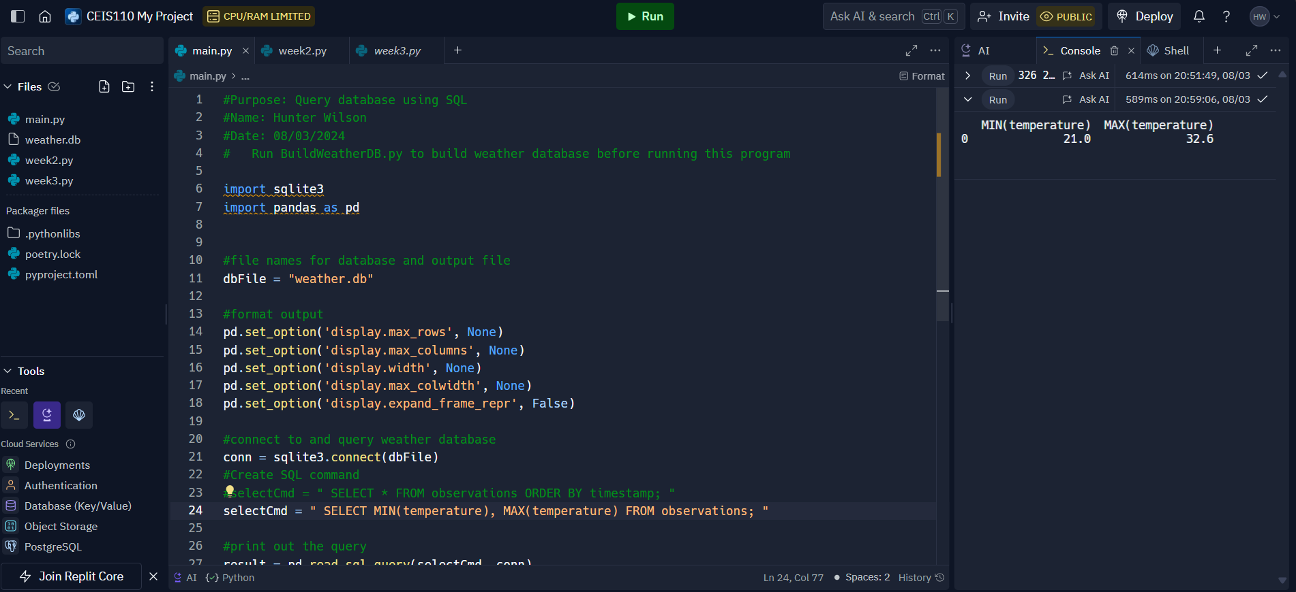
Min & Max Temperature
For my next task in querying the database, I had the string of code find both the minimum and maximum average temperatures for my local area. To do this I first had Python ignore the original selectCmd and replaced it with the new one shown in the right-side image. This allowed the program to specifically pull the min and max temps from the observation table. The data received read as follows:
MIN(temperature) = 21.0C or 69.8F MAX(temperature) = 32.6C or 90.68F

Slide 13
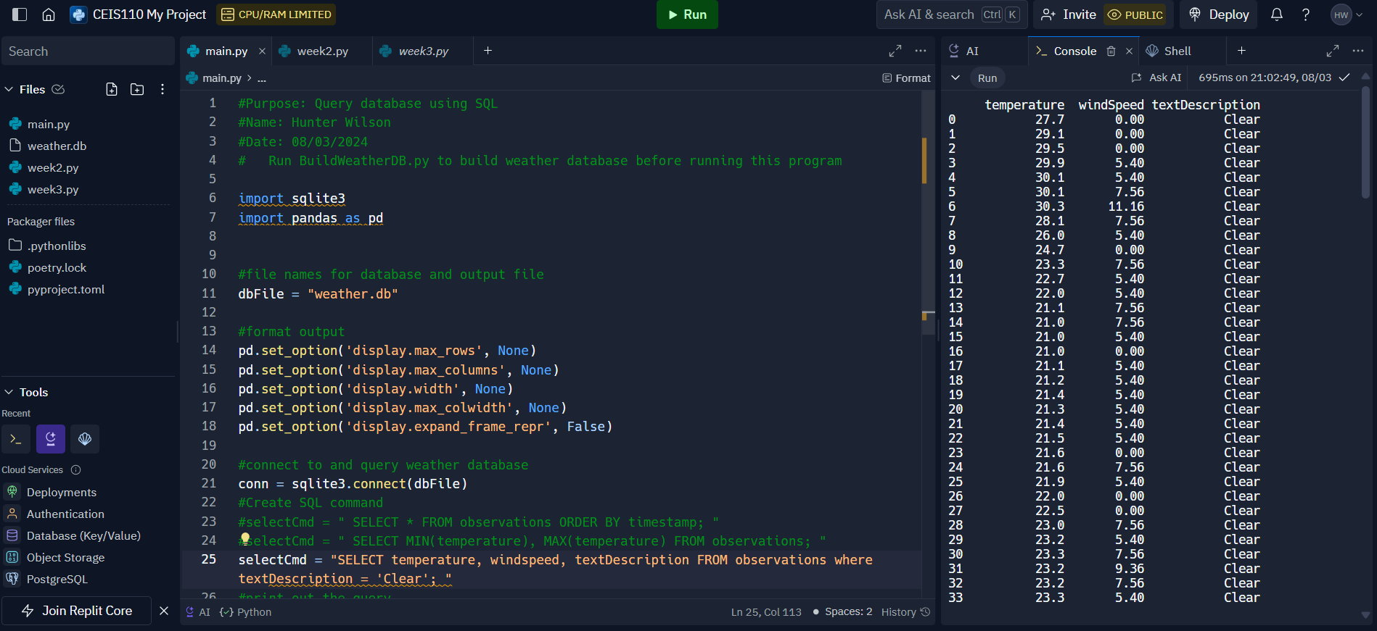
Clear Skies
For my final querying task, I changed the selectCmd once again. This time I made it to where the code would only pull data from the observation table that read Clear in the textDescription column, along with the temperature and windspeed integers.

Slide 14
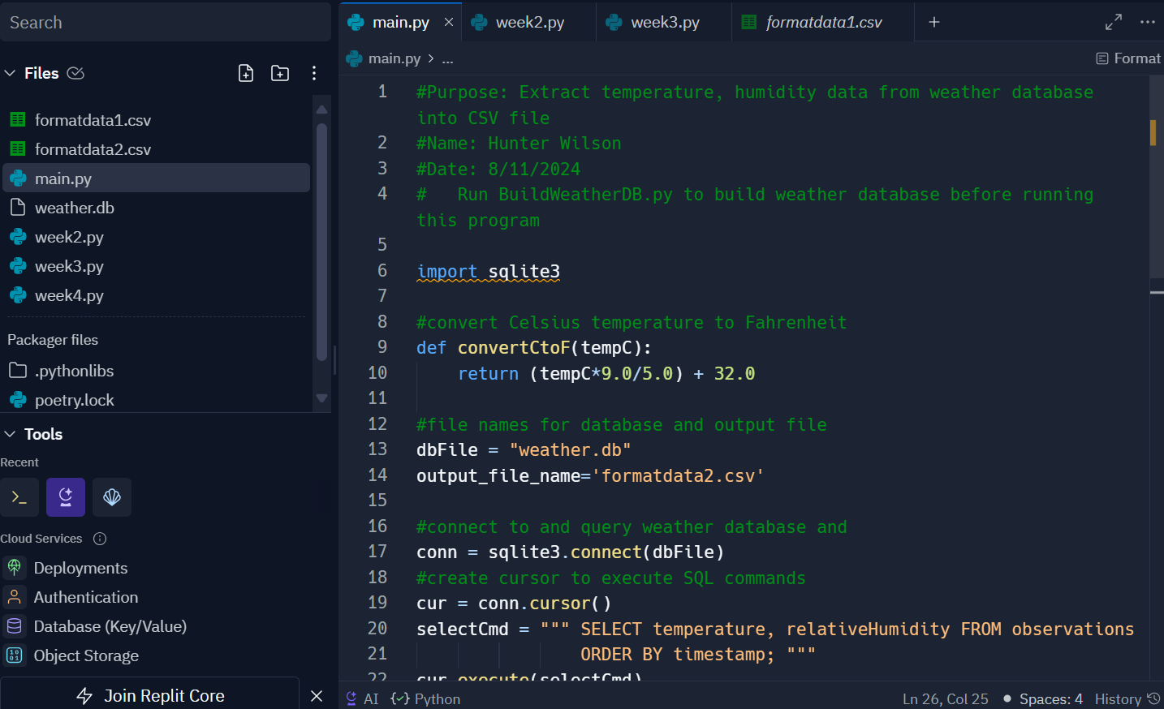
Converting Data To CSV Format
CSV (Comma-separated values) is a simple, yet powerful format used to separate and exchange data often separated by commas in a plain text format. These files are very easy to create while still being very informative and are often used to store data in tabular formats like spreadsheets or databases.
This image shows a string of code I used to extract the temperature and humidity data from the BuildWeather.db file and convert it into a CSV file.

Slide 15
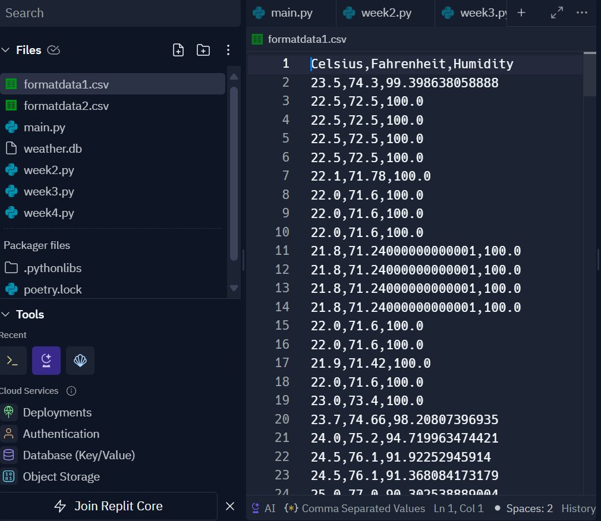
CSV Format Data
This image represents the CSV file (formatdata1.csv) which contains all the data pulled after converting it to the CSV format. The first column shows the temperature in Celsius, followed by the Fahrenheit temperature, and the final column shows the overall humidity for that day. However, this can be hard to read as the commas separating each column can be easily mistaken for periods, so I was then required to find a solution that made the output easier to read.

Slide 16
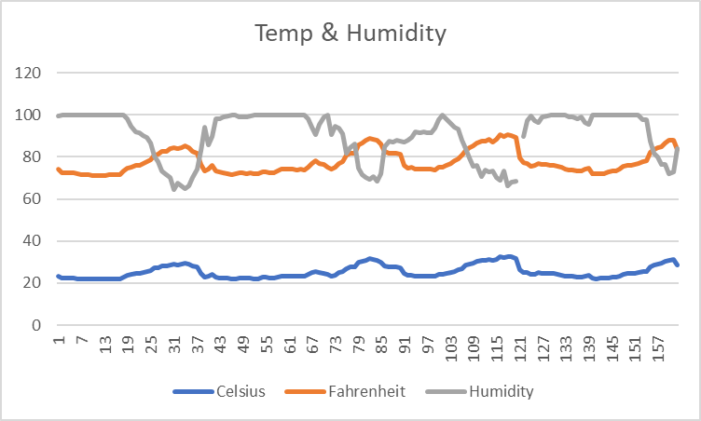
CVS Chart
Once I had all the data pulled from the CSV file, I downloaded the formatdata1csv, copied it into Microsoft Excel and converted the data into numbers. Once converted I saved the Excel template into a new workbook file, this allowed me to put all the data from the CSV file into a chart/graph.

Slide 17
Types of Errors
In CEIS110 we covered the several different types of errors you may encounter when working with Python or any other coding language, such as syntax errors, runtime errors, and logic errors.
Syntax errors, also known as compile-time errors, violate the rules for how Python statements must be written. They are often caught by the IDE before you run the program. A few examples are missing keywords, using parentheses when you should have brackets, misspelling or incorrect capitalizations of a variable/function name, and not checking that a value is the right data type before processing it.
Runtime errors don’t violate syntax rules, but instead throw exceptions that stop the execution of the program, many which are due to programming errors that need fixed but some need to be handled by the program so that it won’t crash.
Logic errors don’t cause syntax or runtime errors but produce the wrong results.
Desk-Checking is a useful technique to help resolve all types of errors up front. This is a method of manually tracing through the logic of a program with a chosen test-data, logic walk-through, code walk-throughs, etc. When paired with try/catch blocks and debugging tools, such as breakpoints, finding errors in your program/code is easy to identify and resolve.

Slide 18
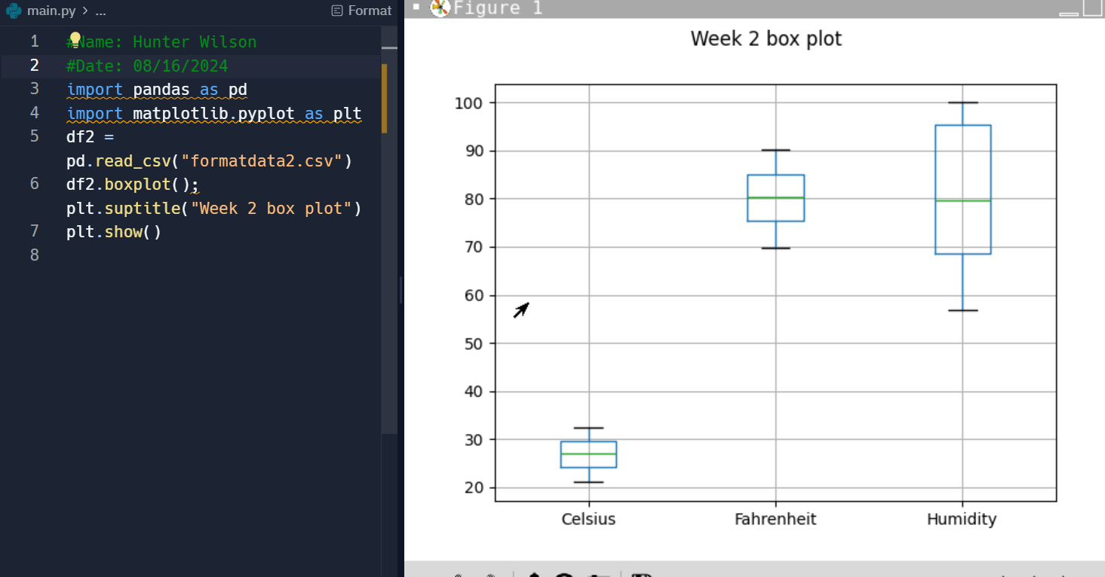
Graphic Models
Part of our last project for the class was turning data into a graphic model, using data from the formatdata1.csv and formatdata2.csv files. This was accomplished by using the import pandas and import matplotib.pyplot.
This image shows a box plot of all the week 2 data from the formatdata2.csv file. It gives an average ranged reading of the Celsius and Fahrenheit temperatures and the overall Humidity.

Slide 19
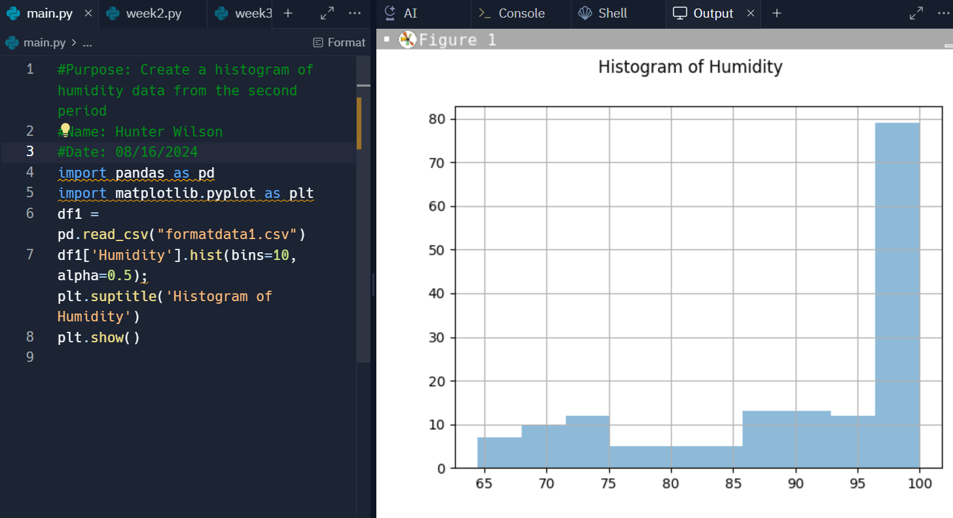
Graphic Models Continued
This is another graph called a Histogram. This graph shows only the humidity recorded from the formatdata1.csv file. The height of each bar indicates how many data points fall within that range, as you can see the first few days where low with a large spike towards the end of the week.

Slide 20
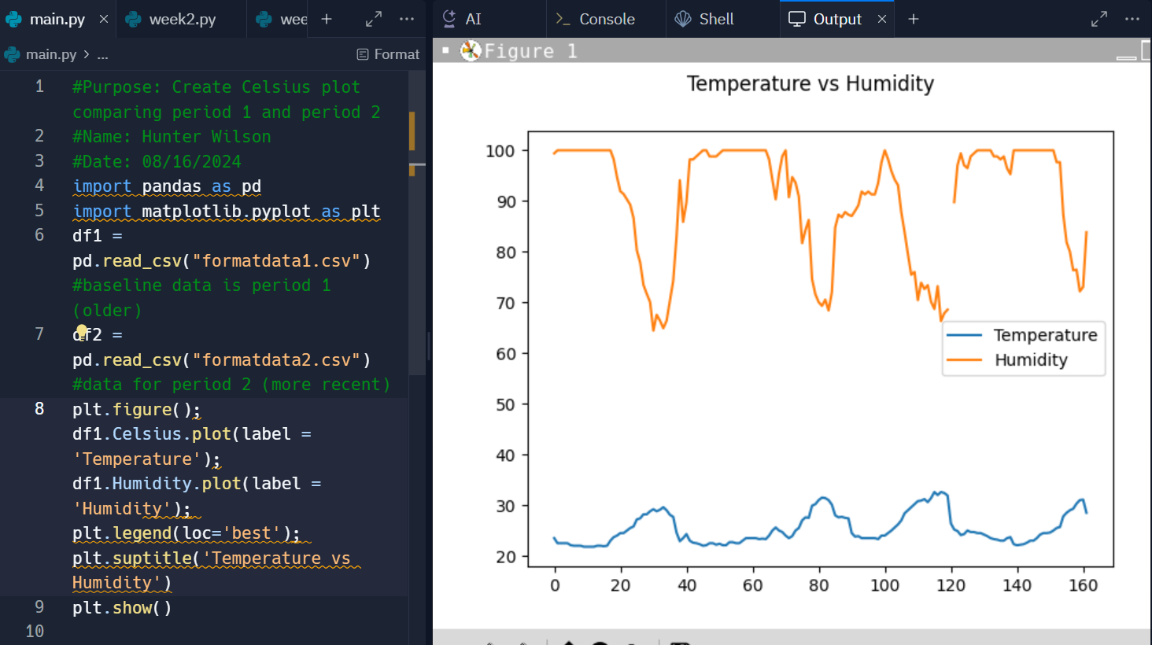
Analysis
For my last graph I was tasked with asking a question about the data and producing a solution. My question was, “what is the relationship between the temperature and humidity?” To find a solution I created a line graph, and had it read and plot the temperature and humidity data from both CSV files, giving the result you see in the image on the right.
Answer: As the humidity goes up the temperature goes down and vice versa.
Prediction: The rise in humidity will result in storms appearing soon, thus resulting in a significant decline in temperature for a few days. Once passed the temperature will increase slightly, and the humidity will decrease slowly.

Slide 21
Conclusion
CEIS110 Intro to Programming has been on of my favorite classes by far. I gained a very thorough understanding of the Python programming language, its functions, how to combat the errors I can potentially encounter, and how to analysis the data recorded in my programs. Programming is an essential skill for data analysis and management. It also inspired me to try my hand at creating my own strings of code for games and analysis of files on my own personal network. With the skills I’ve gained from this class I feel more confident in my ability to properly read, understand, and run my own code/programs.

Slide 22
References
What is SQL? (geeksforgeeks.org)
Pandas DataFrames (w3schools.com)
CSV | A Complete Guide to Comma-Separated Values Files (geeksforgeeks.org)
Catalog | zyBooks

