Slide 1
CEIS 101 The Internet Of Things
Hunter Wilson
Devry University Final Project

Slide 2
Introduction
In this PowerPoint, I will go over everything I learned in CEIS 101 The Internet of Things. In the next several slides you will see the process and steps I took to build a home security system in a virtual lab on Tinkercad. You will also see all the skills I’ve acquired from this course.

Slide 3
Career Skills Acquired.
Base knowledge of IoT connections, usage, and devices.
Network fundamentals and how to connect devices to the network.
Cloud and Fog computing.
Programming Fundamentals.
A base knowledge of business analytics.

Slide 4
Challenges Faced Along The Way
My biggest challenge in this course was communicating with other individuals. The IoT field/industry is constantly evolving, therefore, being able to communicate with others in this field is very important in helping stay up to date on the newest developments. Another challenge was keeping track of all the different types of components as well as software/hardware configurations. The list seemed endless and even understanding the basic configurations and components took time. I look forward to what the future of IoT has in store and welcome the many changes it will provide.

Slide 5
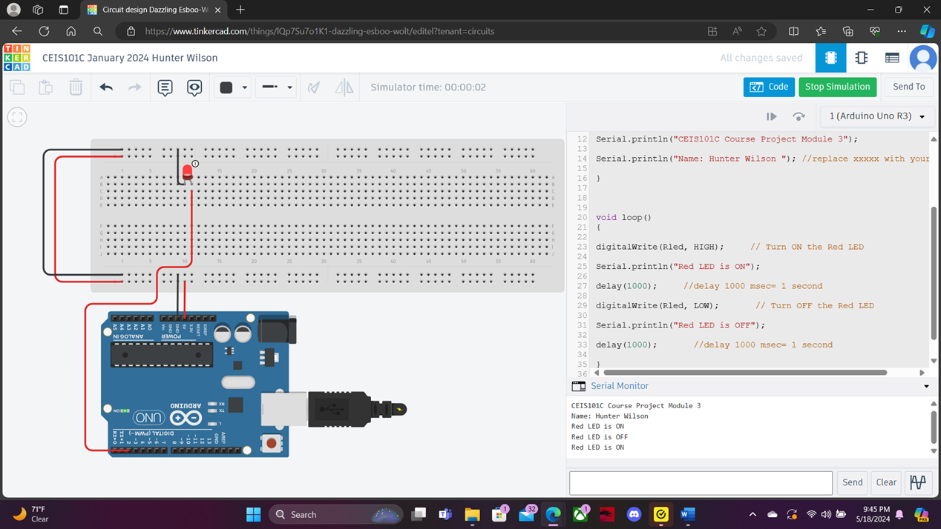
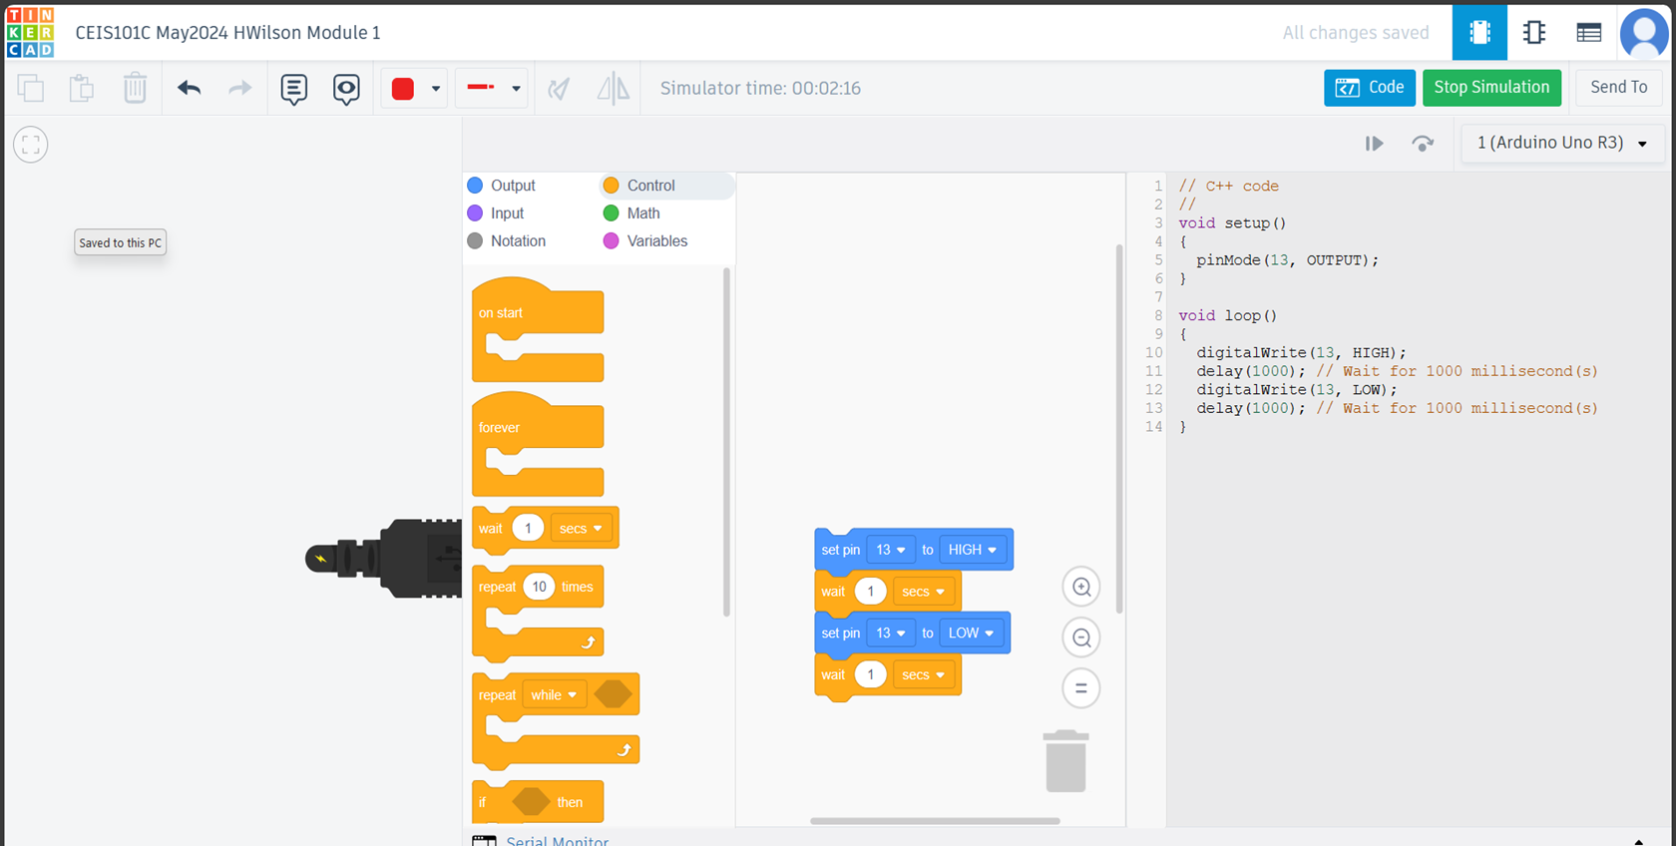
This slide shows the first steps I took in building the smart home security system. The top image displays an Arduino Uno circuit board, a breadboard, a red LED light, and all the wires used to run the system. This light was required to blink every second. The top image is a snapshoot of the serial monitor proving that the light would in fact turn on and off. The bottom image is the code used to start the blink cycle.

Slide 6
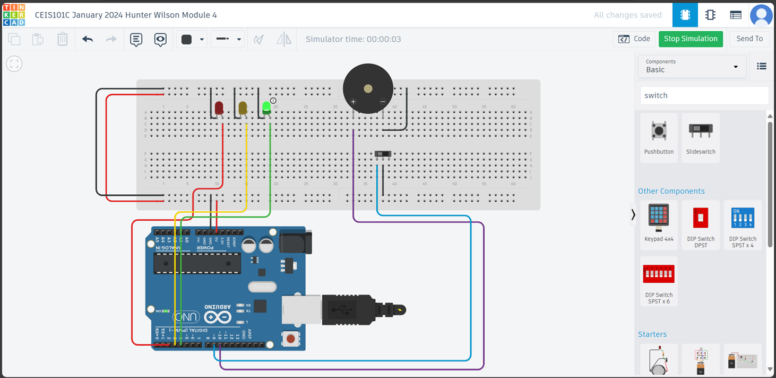
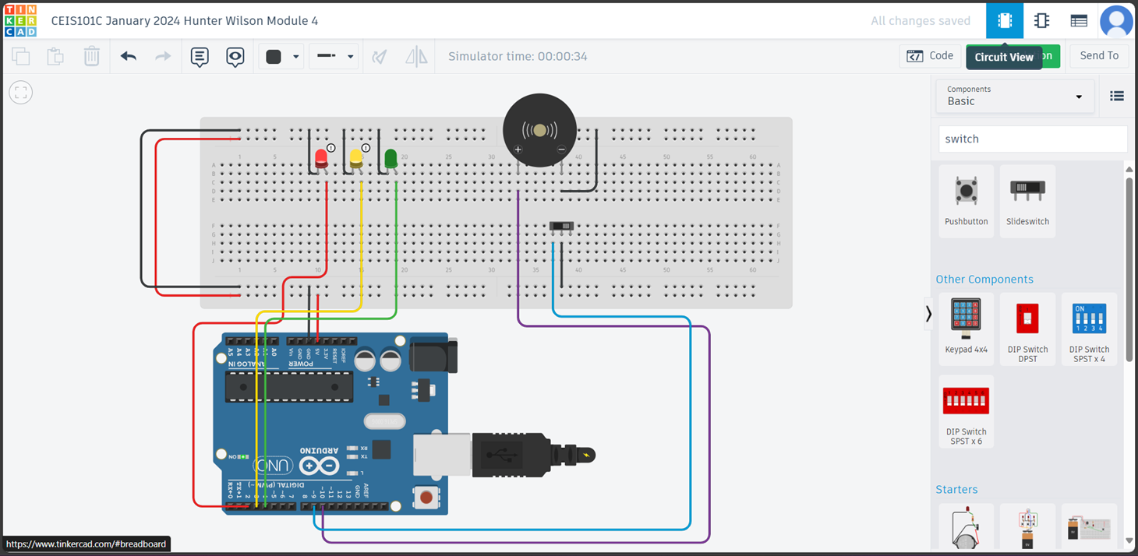
These images show the next step in the class project. First I added two additional LEDs (one yellow and one green), a Piezo alarm, and a slideswitch. The top image is the simulation running, and the security system reading the door as closed with the green LED being on. The bottom image shows the security system reading door open, this was triggered by moving the slideswitch to the opposite side. With the door open the yellow and red LEDs turned on, the green LED turned off, and the Piezo alarm would sound every second to alert the user.

Slide 7
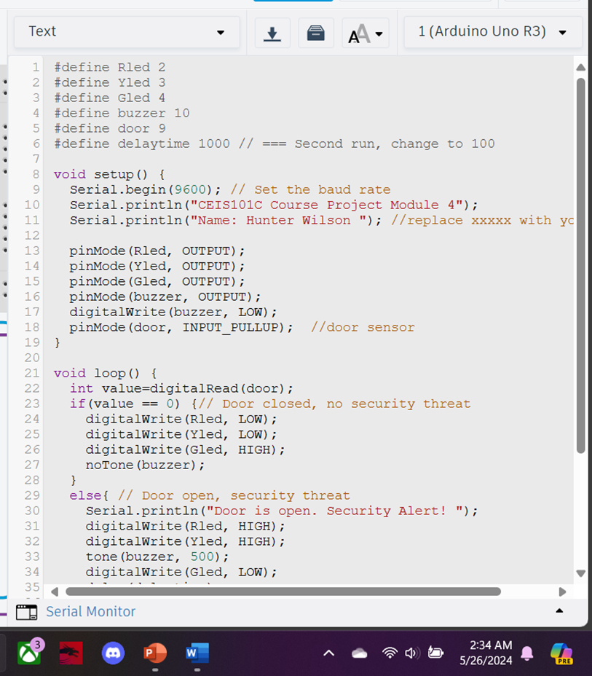
These are images of the code used to run the output of the last slide as well as the serial monitor showing the door being open and providing a security alert.

Slide 8
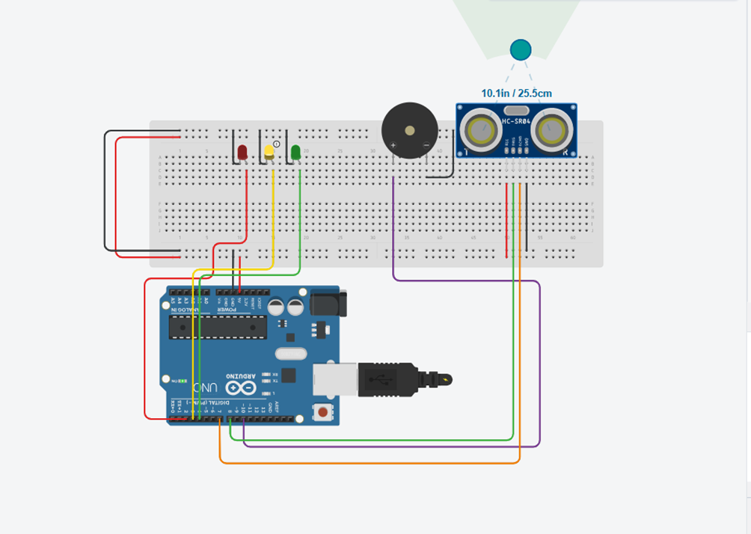
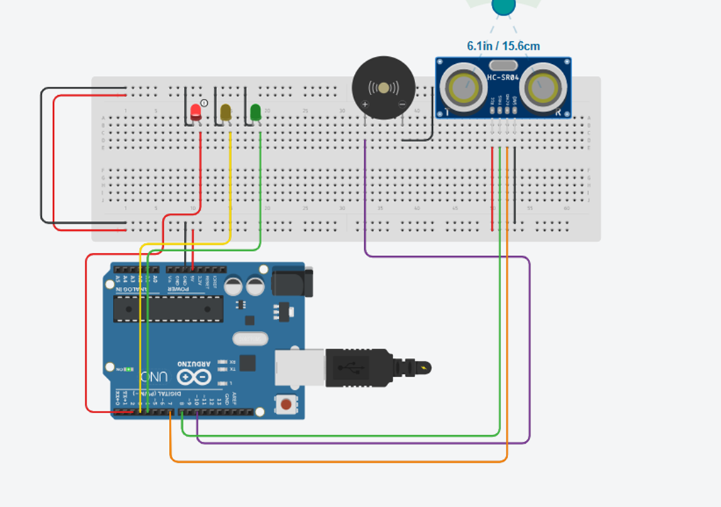
In the next addition of my project, I was tasked with removing the slideswitch and adding an ultrasonic distance sensor. This would allow the security system to detect any motion near the door. First I connected the wires to my breadboard and the Arduino Uno, vcc connecting to the 5v peg of the breadboard, the ground to the negative port of the breadboard, Triq to pin 8, and Echo to pin 7 of the Arduino Uno. The top image shows the yellow LED turning on when anything enters a 10in radius, the bottom image shows the red LED which triggers in a less then 6.5in radius which also triggers the Piezo alarm.

Slide 9
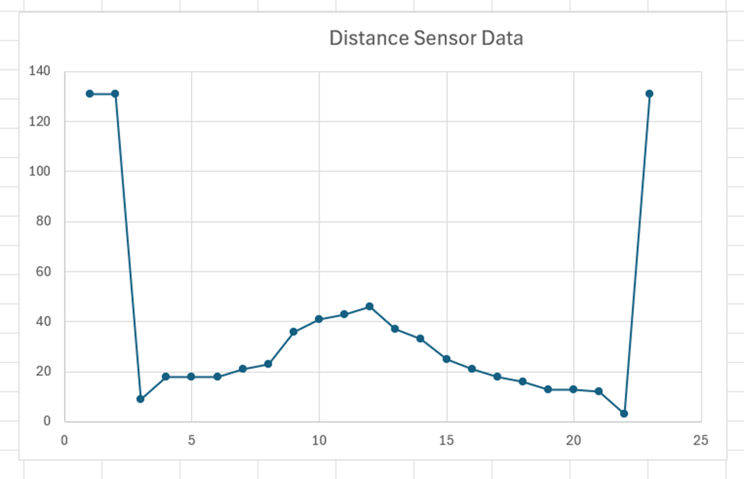
Regarding the previous slide, the bottom image is the code used to run the simulation and the top image is a line graph example of the data collected from the distance sensor in the project. To present this graph I first ran the simulation and moved the “object” in the sensors radius. This gave me different measurements of how closer or far said object was, after copying the data from the serial monitor it was pasted in Excel, and then formatted to fit properly in the brackets before being reorganized into a line graph image.

Slide 10
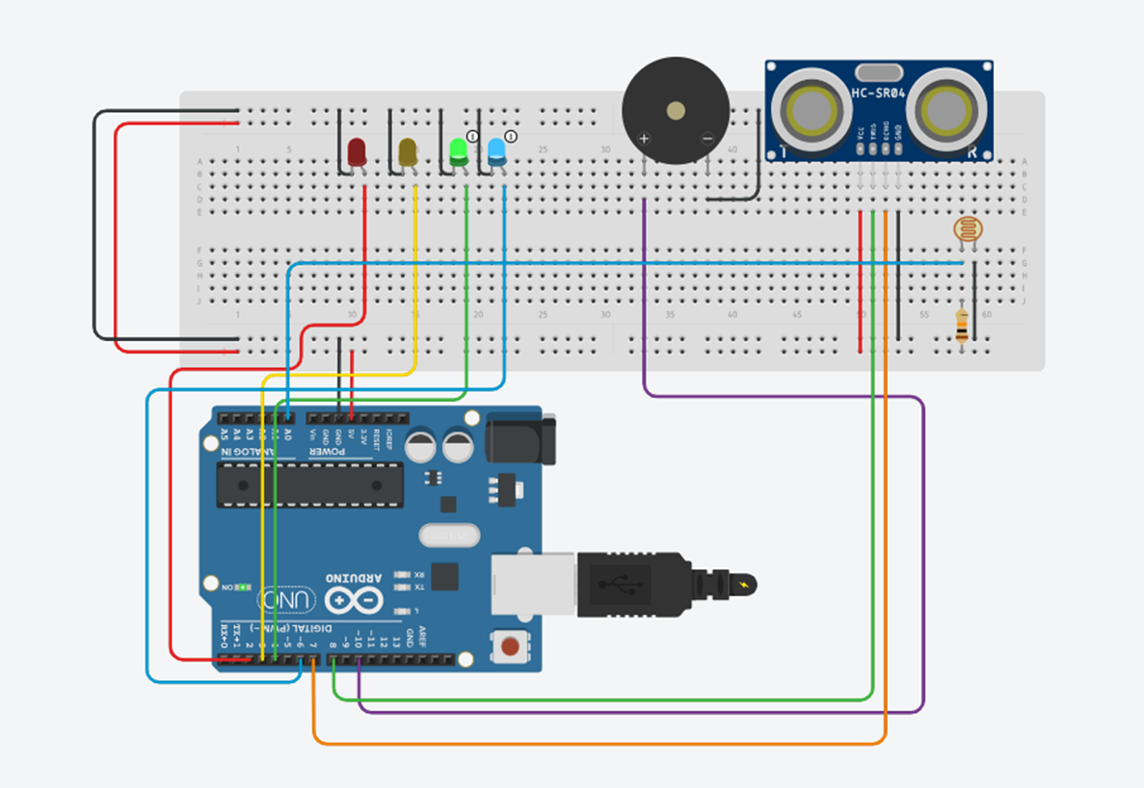
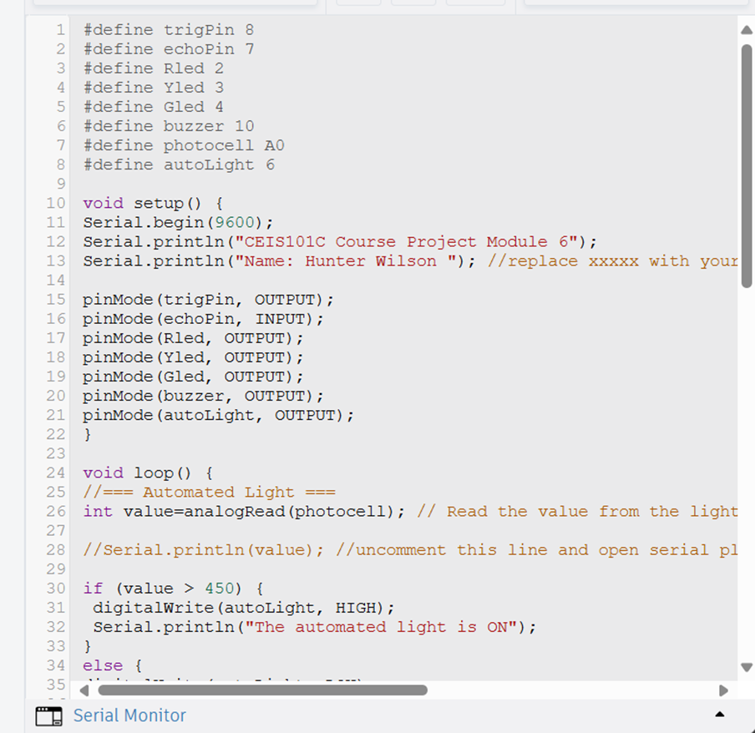
This final slide shows the automation of the security system by connecting a light sensor. By inputting a new series of code, adding a blue LED light, a 10 kΩ resistor, and a light source switch to the breadboard. When the source would turn on the security system would activate the automated light, confirming the security system was running.
Top Image is the automation system running in the simulation, the bottom left image is the code for the automation process, and the bottom right is the serial monitor confirming the automated light is on.

Slide 11
Conclusion
The CEIS 101 class has taught me that the Internet of Things is constantly evolving and there will be continuous improvements and adaptations to overcome. This was simply an introduction into a large field of possibilities limited only by human creativity and what we know. If we can think it, then it can be accomplished. The Internet of Things is currently changing the world, and will continue to do so in both simple and complex ways.

